Slide 1


SoK: A Literature and Engineering Review of Regular Expression Denial of Service (ReDoS)
Masudul Hasan Masud Bhuiyan*, Berk Çakar*,
Ethan H Burmane, James C Davis, Cristian-Alexandru Staicu
∗Both authors contributed equally to this research.
AsiaCCS 2025 | August 2025
Notes:
Thanks for being here. Today I’ll talk about ReDoS attacks—how research has studied them over the past decade, what engineering defenses exist, and the gaps that remain. This is joint work with researchers from CISPA and Purdue University.

Slide 2
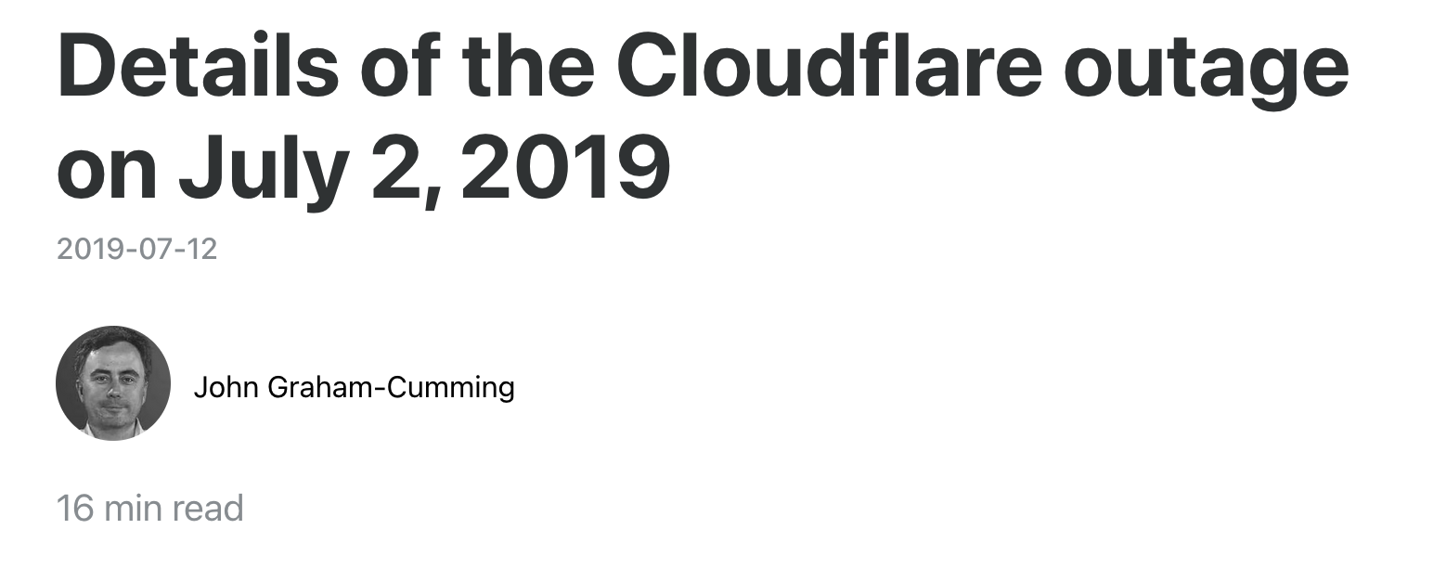





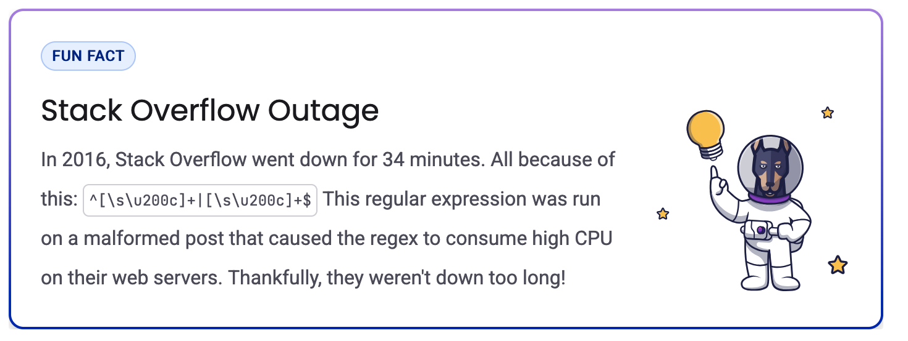

Regular Expression Denial of Service (ReDoS)
input: alice@example.com
Processing time: 1 ms
^([a-zA-Z0-9_.+-]+)+@example\.com$
input: a{40}@example.comX
Processing time: 22 s
Notes:
In general benign user that interacts with an application and it submits such an a benign input and on the server side the developer usually matches this against a regular expression is there either sanitization like matching email input or for extracting certain information from the input and after a constant amount of time it sends back a response to the to the user.
But in redos attack, the attacker sends a very well crafted payload that tries to exploit some particularities of the regular expression matching engine and instead of responding in a constant amount of time the server now responds in a super linear amount of time dependent on the input size and in this way the attacker introduce a lot of useless computational on the on the server side and hamper the service or even break down the server.
Two well-known cases were outages at Stack Overflow in 2016 and Cloudflare in 2019 caused by ReDoS.

Slide 3
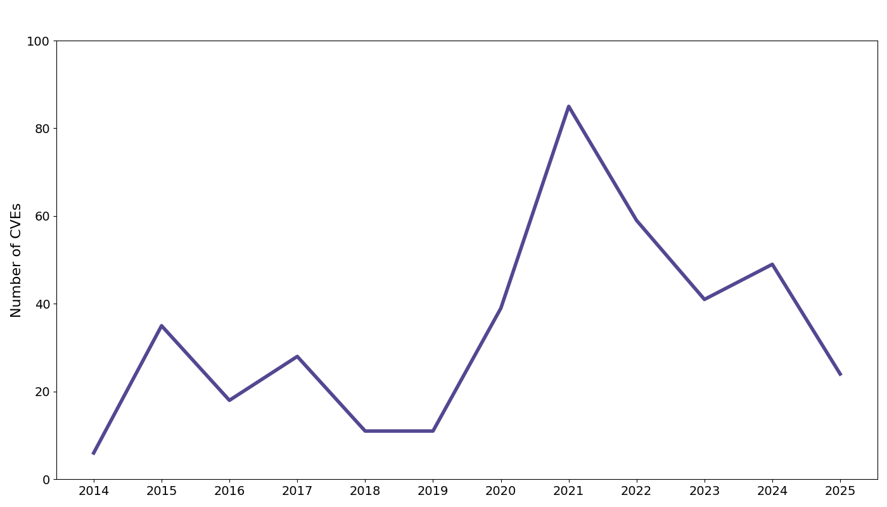
Growth of ReDoS-related CVEs
Number of ReDoS-related CVEs in the NVD over the past 10 years.
Notes:
and it’s not just papers. there are many CVEs tied to redos. the figure shows the volume is high and still growing

Slide 4




Perceptions of ReDoS from Issue Discussions
“…Most ReDOS vulnerabilities are self-attacks, meaning, not a vulnerability.”
“None of these seem like they could be exploitable in real world scenarios. Please let us know if you disagree.”
“Well, congratulations to whoever it is that decided that the right path of action here is getting a CVE for...”
“Pretty much all complex regexes are vulnerable to ReDos…”
https://github.com/sarbbottam/eslint-find-rules/issues/349
https://github.com/facebook/react-native/issues/46996
https://github.com/pytest-dev/py/issues/287
https://github.com/nodemailer/mailparser/issues/378
Notes:
but interestingly many developers tend to ignore redos related security reports.
On github you see replies like ‘most redos bugs are self-attacks, not a vulnerability,’ and ‘none of these seem exploitable in the real world,’ even sarcasm about getting a CVE for redos”

Slide 5
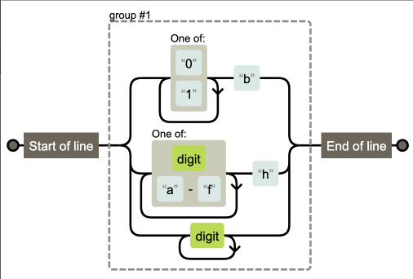



Regex Engines: Backtracking Engines
Spencer's Algorithm
Backtracking Search
Flexible, supports E-regex features
*
Vulnerable to catastrophic
backtracking
Input
Python, C# (.NET), PHP
JavaScript (V8), Ruby, PCRE
/^([01]+b|[\da-f]+h|\d+)$/
*Source: Eloquent JavaScript, Marijn Haverbeke. https://eloquentjavascript.net/09_regexp.html
Notes:
Now to understand redos, we need to look under the hood and. Understand regex engine.
There are various types of engine but most common one is based on Spencer’s algorithm, which uses backtracking. Here the engine tries one possible path, and if it fails, it backtracks and tries another. This supports powerful features like backreferences and lookarounds, but it opens the door to catastrophic backtracking. Languages like Python, .NET, JavaScript’s V8, and Ruby have all used this style.

Slide 6

Literature Review
Analyzing research on regex engines, attacks, and defenses
Notes:
Let’s now turn to the literature.. We’ll look at what has been done, what assumptions these studies make, and where the gaps remain.

Slide 7
Literature Review Methodology
Scope
Years: 2015–2024 Venues:
Security: S&P, USENIX, CCS, NDSS
Software Engineering: ICSE, FSE, ASE
Programming Languages: PLDI, POPL, OOPSLA
16875
Keyword search
ReDoS, denial-of-service, regex, regular expression, regular expression analysis, and regular expression execution
102
Inclusion/
Exclusion
Inclusion: Papers on ReDoS attacks, defenses, detection, or empirical studies on ReDoS
Exclusion: Papers without ReDoS focus or without ReDoS-specific evaluation
93
Analysis
- Research directions (detection, prevention, mitigation)
- Threat models
- Vulnerability definitions
- Evaluation methods
35
Notes:
We reviewed papers on ReDoS published between 2015 and 2024 in top security, software engineering, and programming languages venues. We first filtered relevant papers using keywords such as ReDoS, regular expression, and denial of service, which gave us a total of 93 papers. We then narrowed this down to papers that primarily focus on ReDoS or empirically study DoS. Papers that did not evaluate their proposed methodology for ReDoS were excluded. Additionally, we reviewed related work outside of these venues through backward snowballing, applying the same inclusion and exclusion criteria. Finally, we analyzed the selected papers along four aspects:
their main research direction—detection, prevention, or mitigation;
the threat model they assume;
how they define vulnerable regexes;
and the evaluation methods they use.

Slide 8

Threat Models
28/35
Code Fragment
Notes:
A realistic threat model is essential in any security study. But interestingly, 80% of the studies treated regex as isolated code fragments without considering the surrounding context.
which is one of the main pushbacks from the developer community.

Slide 9




Threat Models
9/35
Library
Code Fragment
Notes:
Only 9 studies extend their analysis to the surrounding context, such as within library code such as NPM, PYPIor Maven

Slide 10




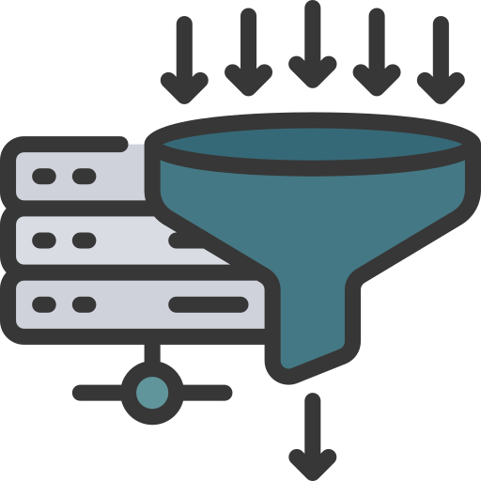
Threat Models
Application
50M ex: Turoňová et al.
1M ex: Li et al.
100K ex: Davis et al.
50k ex: Bai et al.
Library
7/35
13/35 => request limit
Code Fragment
Regex matching with counting-set automata. OOPSLA, 2020
RegexScalpel: Regular Expression Denial of Service (ReDoS) Defense by Localize-and-Fix., USENIX Security, 2022
The impact of regular expression denial of service (ReDoS) in practice: an empirical study at the ecosystem scale, ESEC/FSE, 2018
Runtime Recovery of Web Applications under Zero-Day ReDoS Attacks, IEEE S&P, 2021
Notes:
And finally, only 7 papers considered the threat model at the application level.
Only 13 papers set some limit on the input size an attacker can send, and even those limits are not realistic in real systems. Allowing inputs of 1 million or even 50 million characters does not reflect real-world applications.

Slide 11


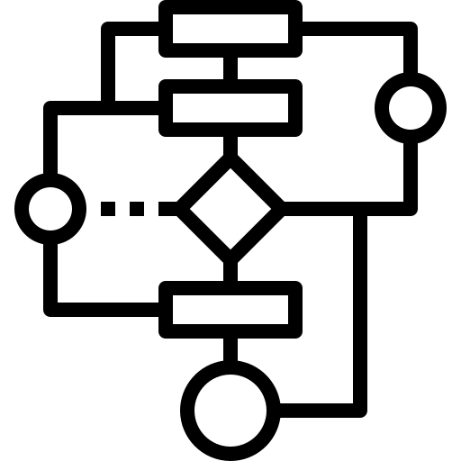

Threat Models: Inconsistencies
Attacker Controls Input
34 studies
Presumes attacker input is matched against a vulnerable regex.
Assumes attacker can manipulate input to exploit vulnerabilities.
Input Reaches Super-Linear Regex
35 studies
Backtracking Engine Use
32 studies
Assumes attackers can send unlimited requests without restriction.
Assumes attacker knows the regex engine and its weaknesses.
Arbitrary Request Assumption
33 studies
Notes:
Now, although only 28% of the papers explicitly define a threat model, all of them implicitly assume one. We found four major assumptions in the existing research.
First, the attacker can manipulate the input to trigger the vulnerability. This is a reasonable assumption and appears in all the papers we studied, but it may not always hold in real systems.
Second, the attacker’s input is matched against a vulnerable regex. This is a strong assumption since it requires detailed knowledge of server-side logic, which is not always accessible.
Third, the attacker knows the regex engine version and its weaknesses. This is a significant assumption, as pinpointing the exact version and its vulnerabilities can be quite difficult.
Finally, the attacker can send any number of requests of any size. This is the strongest and least realistic assumption, as it is almost impossible in real-world systems.

Slide 12


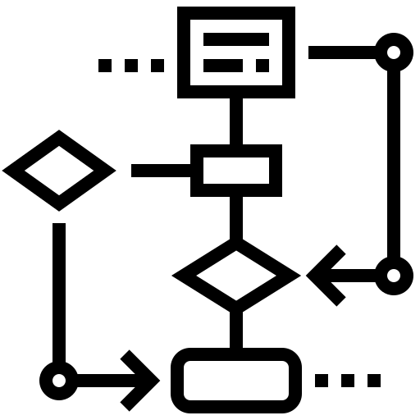

How Do We Define a ReDoS Attack?
Number of Instructions
Slowdown
Heuristics
Threat models must consider the application context
19/29~65%
6/29~20%
5/29~17%
1s ex: Barlas et al.
2s ex: Bhuiyan et al.
5s ex: Staicu et al.
10s ex: McLaughlin et al.
100s ex: Turoňová et al.
safe-regex
ex: Davis et al.
safe-regex
ex: Kluban et al.
safe-regex
ex: Kluban et al.
10⁵ ex: Liu et al.
10⁸ ex: Shen et al.
10¹⁰ ex: Parolini et al.
>10⁴ ex: Su et al.
ReDoS needs standardized definitions and evaluation criteria
Notes:
Now the next question is, how do we define a successful ReDoS attack? What should be the oracle for deciding when a regex is vulnerable?
We found three approaches in the literature. The most common one is slowdown. Six papers define it using the number of executed instructions. And five papers use heuristics.
But even within these categories, there is no uniformity. Different papers use very different thresholds. Some consider slowdowns of 10 or even 100 seconds as the oracle, which is clearly impractical in real systems.
For instruction count, the values range from 10⁴ to as high as 10¹⁰.
This shows the need for standardized definitions and evaluation criteria for ReDoS.

Slide 13

Engineering Review
Reviewing regex engines, vulnerabilities, and defenses
Notes:
Now, It is great that researchers are working on ReDoS, but have their ideas made it into the regex engines developers use?

Slide 14









Regex Engine Defenses Across Languages
Spencer-style backtracking regex engines
Resource capping: counter-based
Thompson-style
non-backtracking engines
Notes:
To find out that we investigated the regex engines used in nine popular programming languages: JavaScript, Ruby, C#, Java, PHP, Perl, Python, Rust, and Go. And we can group them in three categories.
Due to time limit, I discuss the first group as they are most vulnerable ones.

Slide 15



Regex Engine Defenses Across Languages
Non-backtracking engine (2021, v8.8)
Does not support E-regex
Adopted in Node.js as experimental feature
Not enabled by default
ReDoS-Safeness: Partial
Notes:
So, we will start with NodeJS which is built on v8 engine. In 2021 v8 introduce a non-backtracking engine but it has limited support for advance e regex features.
And in version 16 Nodejs adopted it as an experimental features. Thus, it is not enabled by default and not fully safe.

Slide 16
Regex Engine Defenses Across Languages
No documented ReDoS defenses (as of Java 22)
Introduced bounded caching mechanisms (2016)
OpenJDK Java versions ≥9
Enabled by default
ReDoS-Safeness: Partial
Notes:
Now, for java, there is no documented redos defence, but looking into the OpenJDK source code repository and issue tracker, we identified some performance in Java 9 which introduced bounded caching mechanisms for some problematic redos. Although it is enabled by default, it is not fully safe.

Slide 17

Regex Engine Defenses Across Languages
No documented ReDoS defenses (as of Python 3.12)
No timeout or memorization support
ReDoS-Safeness: Not Safe
Notes:
And for python, we did not find any documented defence or preventive mechanism like timeout or memorization. Thus, it is not safe against redos.

Slide 18
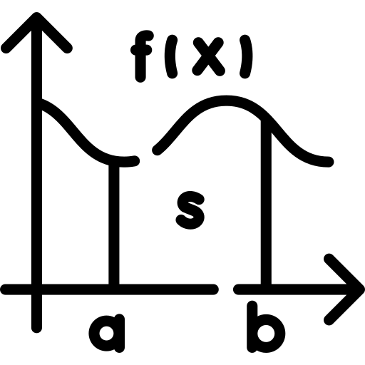






Impact of Engine Updates on ReDoS
Polynomial-time candidates
Exponential
~100k
vuln-regex-
detector
8 Languages
High-Polynomial
500k
500
500
Regex corpus
Low-Polynomial
∼3k
Exponential-time candidates
Linear
Notes:
Now, it is great that engines are being updated, but how much safer are we?
Question: how much safer are regex engines now?
Dataset: ~500K regexes from open-source [18]
Tool: vuln-regex-detector → flagged exponential/polynomial cases
Generated attack strings for candidates
Ran regex–input pairs on old vs. latest engine versions
Measured runtime and categorized results
exponential behavior is resolved in C# and JavaScript but persists in Ruby and Java
polynomial behavior continues to manifest in JavaScript and Java.

Slide 19







What Does It All Mean?
1
2
3
Risk depends on engine, threat model, limits.
Can attacker really send huge inputs?
Defaults, safe modes, defenses
ReDoS is contextual
Better threat model
Know your engine
https://github.com/PurdueDualityLab/SoKReDoS-ASIACCS25
Notes:
ReDoS is Contextual
Risk depends on engine version, threat model, resource limits
Example: super-linear regex is worse in single-threaded Node.js
Question the Threat Model
Many studies assume unlimited payloads and access
Real systems have caps, throttling, or WAF filters
Know Your Regex Engine
Default behavior and defenses vary across languages
Safer modes may exist, but not always enabled by default
Look Beyond Regexes
Other slow code paths can also cause stalls
Profiling, loop removal, and timeouts reduce exposure

Slide 20

Extra Slides

Slide 21
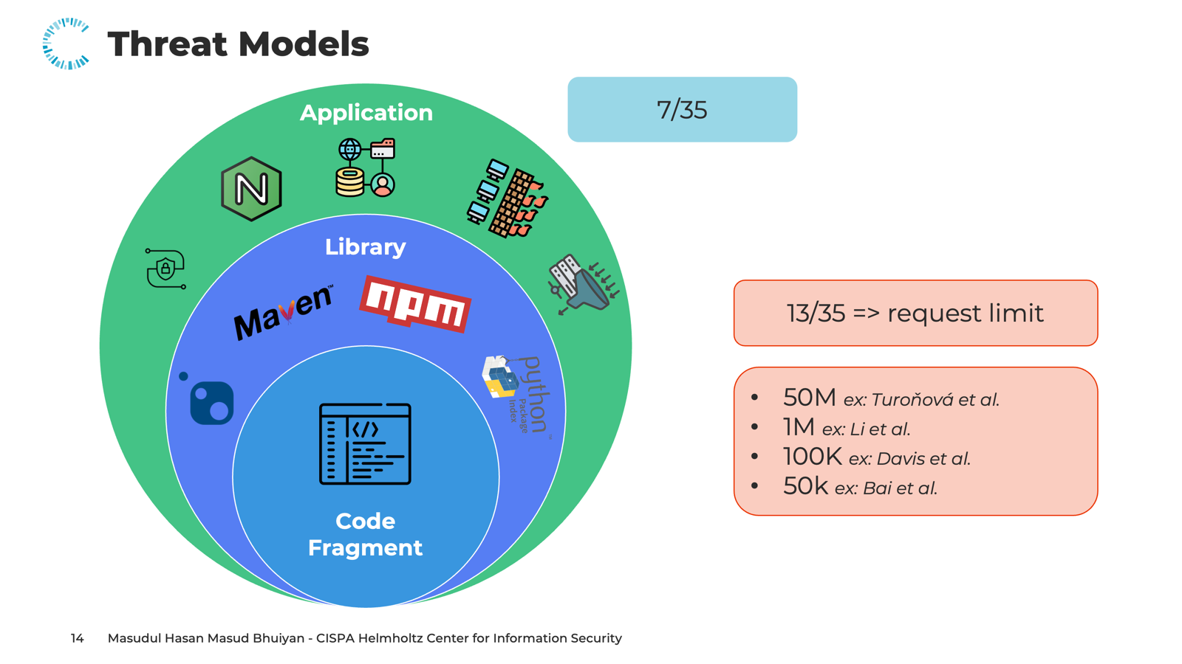
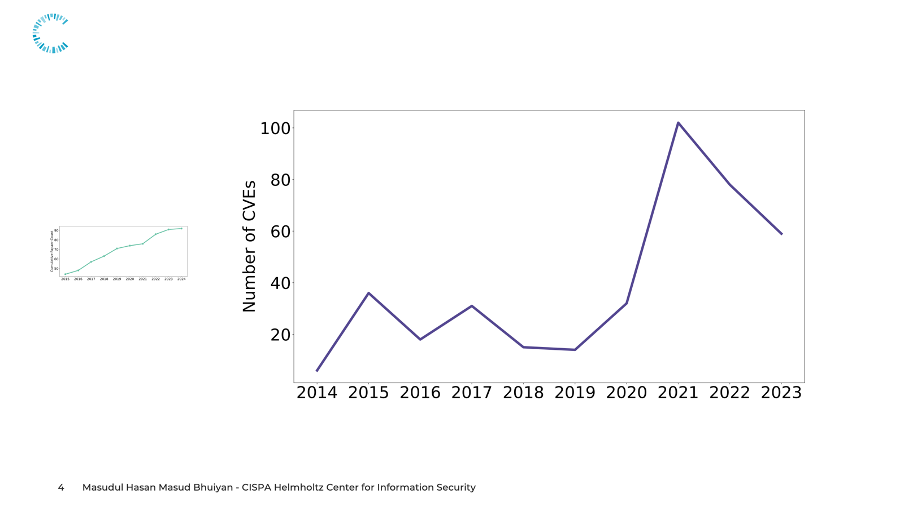
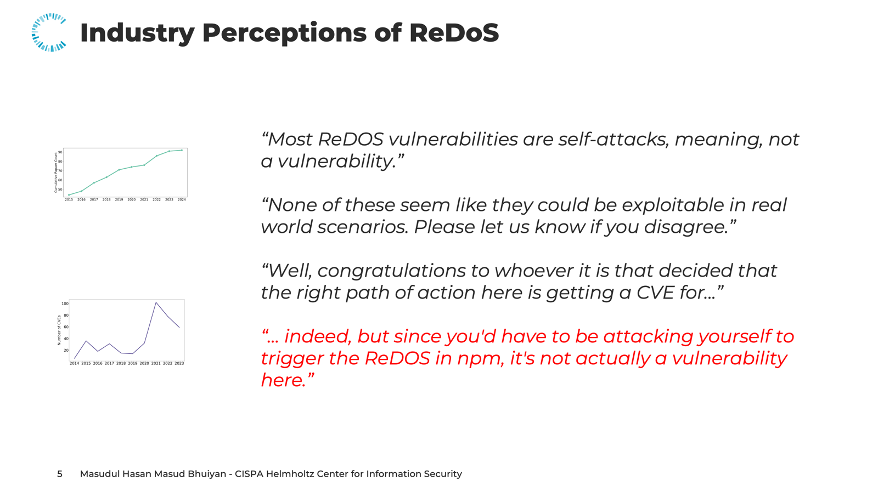
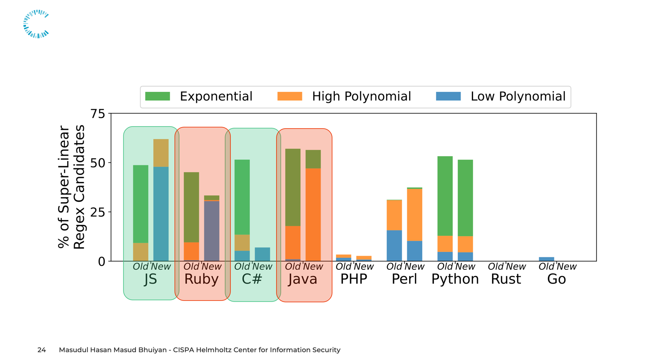
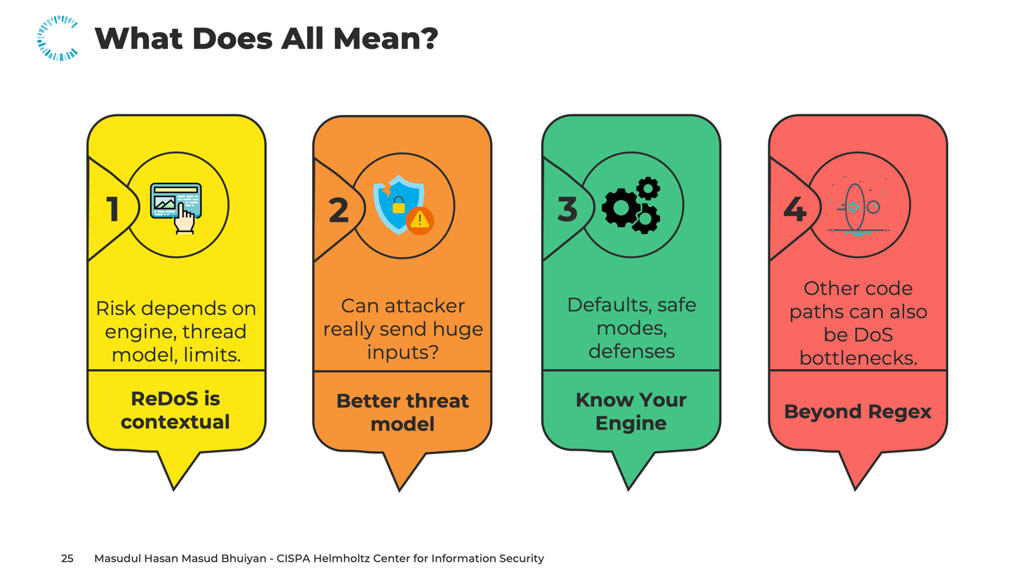
Conclusion
https://github.com/PurdueDualityLab/SoKReDoS-ASIACCS25

Slide 22
A Decade of ReDoS Papers in Top Venues
Total number of papers over the years related to ReDoS and regex published in top venues across security (S&P, USENIX, CCS, NDSS), software engineering (ICSE, FSE, ASE), and programming languages (PLDI, POPL, OOPSLA).
Notes:
redos is a known problem. over the last decade, top security, software engineering, and PL venues kept publishing on it. the figure shows steady activity across S&P, USENIX, CCS, NDSS, ICSE, FSE, ASE, PLDI, POPL, and OOPSLA.”

Slide 23
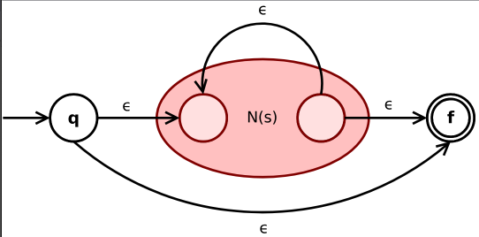
Regex Engines: Thompson-style Engines
Thompson's Algorithm
NFA/DFA Simulation
Linear time performance
Input
Limited E-regex support
RE2, Rust engine
Notes:
To understand why ReDoS happens, we need to look at the regex engines themselves. The vulnerability isn’t just about the pattern, it’s about how the engine processes it. There are two main families of engines. Thompson’s algorithm-based engines strictly follow automata theory. They simulate an automaton and guarantee linear-time performance. That makes them safe, but they can’t support many of the advanced regex features developers like. Engines such as RE2 and Rust fall into this category.

Slide 24








Recipe for a ReDoS Attack
Backtracking Engine
Vulnerable Regex
Attacker-Controlled Input
Using Selective Memoization to Defeat Regular Expression Denial of Service (ReDoS). James C. Davis, Francisco Servant, and Dongyoon Lee
IEEE Symposium on Security and Privacy (SP), 2021
Notes:
"So, for a ReDoS attack we need a vulnerable regex engine, which in most cases is a backtracking engine. Then we need a vulnerable regex. Next, there has to be a carefully crafted input from the attacker to trigger the exploit. Finally, if the targeted system does not have proper safeguards like a firewall or rate limiting, the ReDoS attack will succeed. These four parts form the threat model that we will discuss later."

Slide 25
Catastrophic Backtracking
Super-linear regex: ^(a+)+$
a
q^
ε
q₁
a
q₂
ε
q$
!
ε
Mismatch
Input: aaaa…aa!
Input: aaa
Exponentially different paths
Notes:
No, here is how the catastrophic backtracking happens:
This is an example of super linear regex. This is the NFA for is this regex.
Now let’s say the input is triple a. Then it moves from q0 to q1, to q2, and loops through q2 and finally reaches the end state. But if the input is a bunch of a’s and ends with an exclamation mark, the algorithm will backtrack to a previous step and explore many redundant paths when it finds a mismatch, until all paths are explored."

Slide 26

What Does It All Mean?
1
2
3
4
Other code paths can also be DoS bottlenecks.
Risk depends on engine, threat model, limits.
Can attacker really send huge inputs?
Defaults, safe modes, defenses
ReDoS is contextual
Better threat model
Know your engine
Beyond regex
https://github.com/PurdueDualityLab/SoKReDoS-ASIACCS25
Notes:
ReDoS is Contextual
Risk depends on engine version, threat model, resource limits
Example: super-linear regex is worse in single-threaded Node.js
Question the Threat Model
Many studies assume unlimited payloads and access
Real systems have caps, throttling, or WAF filters
Know Your Regex Engine
Default behavior and defenses vary across languages
Safer modes may exist, but not always enabled by default
Look Beyond Regexes
Other slow code paths can also cause stalls
Profiling, loop removal, and timeouts reduce exposure

Slide 27
Industry Perceptions of ReDoS
General PR merge Rate: 65%*
“Most ReDOS vulnerabilities are self-attacks, meaning, not a vulnerability.”
“None of these seem like they could be exploitable in real world scenarios. Please let us know if you disagree.”
“Well, congratulations to whoever it is that decided that the right path of action here is getting a CVE for...”
“Pretty much all complex regexes are vulnerable to ReDos…”.”
*On the use of dependabot security pull requests
Mahmoud Alfadel, Diego Elias Costa, Emad Shihab, and Mouafak Mkhallalati, MSR-2021
Notes:
the data matches this attitude. only 51% of redos PRs get merged, while the general merge rate is 65%.

Slide 28
Regex Engine Defenses Across Languages
Introduced timeout mechanism (.NET v4.5, 2012)
Added non-backtracking engine based on
Brzozowski derivatives (.NET v7, 2022)
❌ Does not support E-regex
❌ Defenses are opt-in only
ReDoS-Safeness: Partial

Slide 29
Regex Engine Defenses Across Languages
Added memorization scheme as defence (v3.2, 2022)
Apply full memorization
Added timeout mechanism (fallback for E-regex)
Enabled by default
ReDoS-Safeness: Partial

Slide 30
Regex Engine Defenses Across Languages
Spencer-style backtracking regex engines
Resource Capping: Counter-based
Thompson-style
non-backtracking engines
Notes:
To find out that we investigated the regex engines used in nine popular programming languages: JavaScript, Ruby, C#, Java, PHP, Perl, Python, Rust, and Go. And we can group them in three categories.
Due to time limit, I discuss the first group as they are most vulnerable ones.

Slide 31
Spencer-style backtracking regex engines
Resource Capping: Counter-based
Thompson-style
Non-backtracking engines

Slide 32



Realistic Evaluations
Refined Threat Models
Broader Scope
Evaluate ReDoS attacks under realistic deployment conditions (e.g., cloud, reverse proxies).
Restrict attacker capabilities to realistic payload sizes and modest bandwidths.
Study the general problem of weaponizing slow computation beyond ReDoS.

Slide 33
“Most ReDOS vulnerabilities are self-attacks, meaning, not a vulnerability.”
“None of these seem like they could be exploitable in real world scenarios. Please let us know if you disagree.”
“Well, congratulations to whoever it is that decided that the right path of action here is getting a CVE for...”
“… indeed, but since you'd have to be attacking yourself to trigger the ReDOS in npm, it's not actually a vulnerability here.”
Notes:
but interestingly many developers tend to ignore redos related security reports.
On github you see replies like ‘most redos bugs are self-attacks, not a vulnerability,’ and ‘none of these seem exploitable in the real world,’ even sarcasm about getting a CVE for redos”

Slide 34
General PR merge Rate: 65%*
Most ReDOS vulnerabilities are self-attacks, meaning, not a vulnerability.
None of these seem like they could be exploitable in real world scenarios. Please let us know if you disagree.
Well, congratulations to whoever it is that decided that the right path of action here is getting a CVE for...
*On the use of dependabot security pull requests
Mahmoud Alfadel, Diego Elias Costa, Emad Shihab, and Mouafak Mkhallalati, MSR-2021
Notes:
the data matches this attitude. only 51% of redos PRs get merged, while the general merge rate is 65%.

